Slide 1
EVACUATION!!
Presented by:
Corrales Fire Department

Slide 2
Anthony J. Martinez
Tanya R Lattin
Corrales Fire Department

Slide 3
Catherine Keller
Bryah Lattin-Montano
Corrales Animal Services

Slide 4
Evacuation:
e·vac·u·a·tion [i-vak-yoo-ey-shuh-n] – noun
1.the act or process of evacuating, or the condition of being evacuated; discharge or expulsion, as of contents.

Slide 5
Have a Plan
Know your Plan
Share your plan

Slide 6
Evacuation
You should practice your emergency plan
You don’t have to wait for officials to say “ evacuate” be proactive

Slide 7
READY-Prepare Now
Be aware of the hazards that can threaten your community.
Take steps now to prepare for seasonal threats.
Register with your county/tribal emergency notification system.
Connect with your local emergency management office, sheriff's office and public health department on social media.
Make a family evacuation and communication plan that includes family phone numbers, out-of-town contacts and family meeting locations. Keep in mind physical distancing recommendations, wearing face coverings or other public health recommendations.
Build an emergency go kit with enough food, water and necessary supplies for at least 72 hours. Include supplies to help keep you and your family healthy, such as face coverings, hand sanitizer and sanitizing wipes. Start with the five P’s; people and pet supplies, prescriptions, papers, personal needs and priceless items.
Check with your neighbors, family, friends and elders through video chats or phone calls to ensure they are READY.
Keep up to date on local news, weather watches, weather warnings and public health recommendations

Slide 8
SET – Be Alert
Know there is significant danger in your area.
Residents should consider voluntarily relocating to a shelter or with family/friends outside the affected area. Residents should avoid close contact with those who are sick and should practice public health recommendations when relocating.
Grab your emergency go kit.
Keep in mind unique needs for your family or special equipment for pets and livestock.
Stay aware of the latest news and information from public safety and public health officials.
This might be the only notice you receive. Emergency services cannot guarantee they will be able to notify everyone if conditions rapidly deteriorate. Be SET to GO.

Slide 9
GO! – Evacuate
Danger in your area is imminent and life threatening.
Residents should evacuate immediately to a shelter or with family/friends outside of the affected area. Residents should avoid close contact with those who are sick and should practice public health recommendations when relocating.
If you choose to ignore this advisement, you must understand emergency services may not be able to assist you further.
Follow instructions from emergency personnel, stay on designated evacuation routes and avoid closed areas.

Slide 10
Evacuation
Responsibility of each individual to have a plan
Readily accessible medication
Important papers
Emergency contacts-at least 1 out of state
Phone chargers

Slide 11
5 P’s of Evacuation
People and Pets and other animals/livestock and supplies.
Prescriptions with dosages, medicines, medical equipment, vision and hearing aids, batteries and power cords, face coverings, hand sanitizer and sanitizing wipes.
Papers including important documents (hard copies and/or electronic copies saved on external hard drives or thumb drives), insurance papers, contacts.
Personal Needs including clothing, water, baby supplies, food, cash, credit cards, first aid kits, phones, and chargers. Items for people with access and/or functional needs, such as older adults and children.
Priceless items including photos, irreplaceable mementos and other valuables.

Slide 12
Evacuation
Animal needs,
identification,
Transport
Kennels
Halters collars leads
Food

Slide 13
Evacuation
If you have a “pet sitter” they need to know your plan
Identification
Tags
Tape on halters
Hoof black or shoe polish
Braid identification in to mane

Slide 14
Evacuation V. Shelter In Place
Evacuation
Shelter In Place
Evacuees must leave the area for their own safety
Voluntary – citizens are requested to evacuate of their own volition
“Mandatory” – citizens must leave for their safety and that of emergency personnel
Shut off air conditioners if from Hazardous air condition in the air IE smoke, Hazardous material, secure your property, etc.
Citizens are allowed to stay at their residence
Stay in doors
Shut off air conditioners if from Hazardous air condition in the air IE smoke, Hazardous material
Prepare for evacuation in the event it becomes necessary

Slide 15
/www.readyforwildfire.org/

Slide 17
Zone 0 touching building
Use hardscape like gravel, pavers, concrete and other noncombustible mulch materials. No combustible bark or mulch
Remove all dead and dying weeds, grass, plants, shrubs, trees, branches and vegetative debris (leaves, needles, cones, bark, etc.); Check your roofs, gutters, decks, porches, stairways, etc.
Remove all branches within 10 feet of any chimney or stovepipe outlet
Limit plants in this area to low growing, nonwoody, properly watered and maintained plants
Limit combustible items (outdoor furniture, planters, etc.) on top of decks
Relocate firewood and lumber to Zone 2
Replace combustible fencing, gates, and arbors attach to the home with noncombustible alternatives
Consider relocating garbage and recycling containers outside this zone
Consider relocating boats, RVs, vehicles and other combustible items outside this zone

Slide 18
Zone 1 – Lean, Clean and Green Zone
Zone 1 extends 30 feet from buildings, structures, decks, etc. or to your property line, whichever is closer.
Remove all dead plants, grass and weeds (vegetation).
Remove dead or dry leaves and pine needles from your yard, roof and rain gutters.
Remove branches that hang over your roof and keep dead branches 10 feet away from your chimney.
Trim trees regularly to keep branches a minimum of 10 feet from other trees.
Relocate wood piles to Zone 2.
Remove or prune flammable plants and shrubs near windows.
Remove vegetation and items that could catch fire from around and under decks, balconies and stairs.
Create a separation between trees, shrubs and items that could catch fire, such as patio furniture, wood piles, swing sets, etc.

Slide 19
Zone 2 – Reduce Fuel Zone
Zone 2 extends from 30 feet to 100 feet out from buildings, structures, decks, etc. or to your property line, whichever is closer.
Cut or mow annual grass down to a maximum height of 4 inches.
Create horizontal space between shrubs and trees. (See diagram)
Create vertical space between grass, shrubs and trees. (See diagram)
Remove fallen leaves, needles, twigs, bark, cones, and small branches. However, they may be permitted to a depth of 3 inches.
All exposed wood piles must have a minimum of 10 feet of clearance, down to bare mineral soil, in all directions.

Slide 20
Zone 1 and 2
“Outbuildings” and Liquid Propane Gas (LPG) storage tanks shall have 10 feet of clearance to bare mineral soil and no flammable vegetation for an additional 10 feet around their exterior.

Slide 21
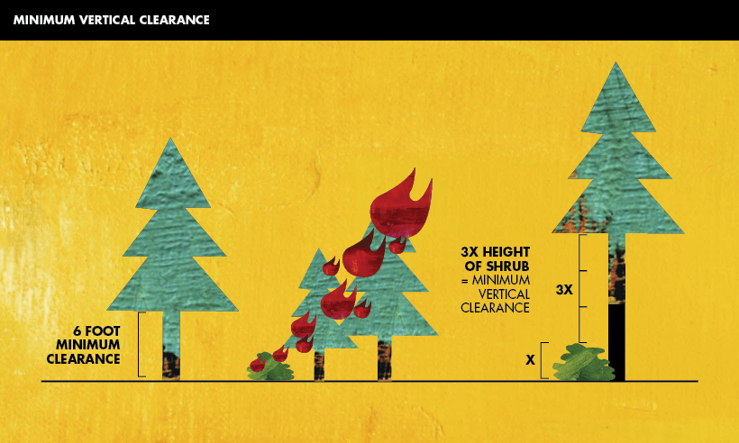
Zone 1 and 2
“Outbuildings” and Liquid Propane Gas (LPG) storage tanks shall have 10 feet of clearance to bare mineral soil and no flammable vegetation for an additional 10 feet around their exterior.

Slide 22
The pressing questions
Who can order an evacuation?
How and when will citizens be notified to move out of harms’ way?
What are the evacuee’s responsibilities?
Where do evacuees go?
How do evacuees get to where they are going?

Slide 23
Who can order an evacuation?
The Village of Corrales Situation Analysis Team (SAT) is responsible for making the decision to shelter in place or evacuate
SAT is made up of the Mayor, Village Administrator, Emergency Manager, Fire Chief, and Police Chief
Three of the five must agree before evacuation order can be made or under IC discretion if imminent life threat
All members present will be made aware of all aspects of the situation by the incident commander before the decision is made

Slide 24
How and when will citizens be notified?
Once the decision is made citizens will be notified in a timely and efficient manner
CodeRed (SIGN UP IF YOU HAVE NOT ALREADY!)
Media-Local TV and Radio
Law Enforcement
Next Door
Twitter- CorralesVillage
Other

Slide 25
Evacuee’s responsibilities
It is the citizen’s responsibility to evacuate
All citizens must have their own plan
If you have special needs that make evacuation on your own impossible have a plan for obtaining assistance
Know what necessities must be taken
Know where to go
Follow directions from law enforcement, fire personnel, and animal services

Slide 26
Where to go?
Family or friends outside of the evacuation zone
Designated evacuation centers
Stop at the designated evacuation center or follow media directions on how to contact the center. Why? If family and friends cannot find you, the center can confirm your safety. This also prevents emergency services from looking for you in an evacuation zone

Slide 27
How do I get there?
Follow Emergency official’s directions
CodeRed message
Local Television and Radio
Identified routes
Know where you are going before you hit the road
Try and have at least two routes to safety in mind
Close vents in car to only recirculate air if driving through smoke
Follow Directions! It is for your own safety

Slide 28
If I want to help ?
Training required – why
ICS 700.b https://emilms.fema.gov/is_0700b/curriculum/1.html
ICS 100.c https://emilms.fema.gov/is_0100c/curriculum/1.html
Dangers of unrequested help
Chain of Command
Accountability

Slide 29
Resources
CodeRed: https://public.coderedweb.com/cne/en-US/BFB7CC4C6C0A
www.ready.gov
www.FEMA.gov
www.readyforwildfire.org
www.wildlandfirersg.org
http://www.humanesociety.org/issues/animal_rescue/tips/pet_disaster_preparedness_kit.html?credit=web_id97309811

