Slide 1
Corrales Parks and Recreation Survey

Slide 2
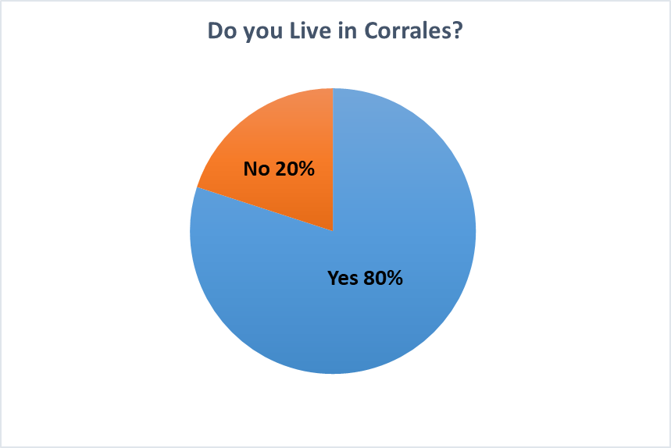
Overview
426 Participants
352 Villagers
74 Non-Residents

Slide 5
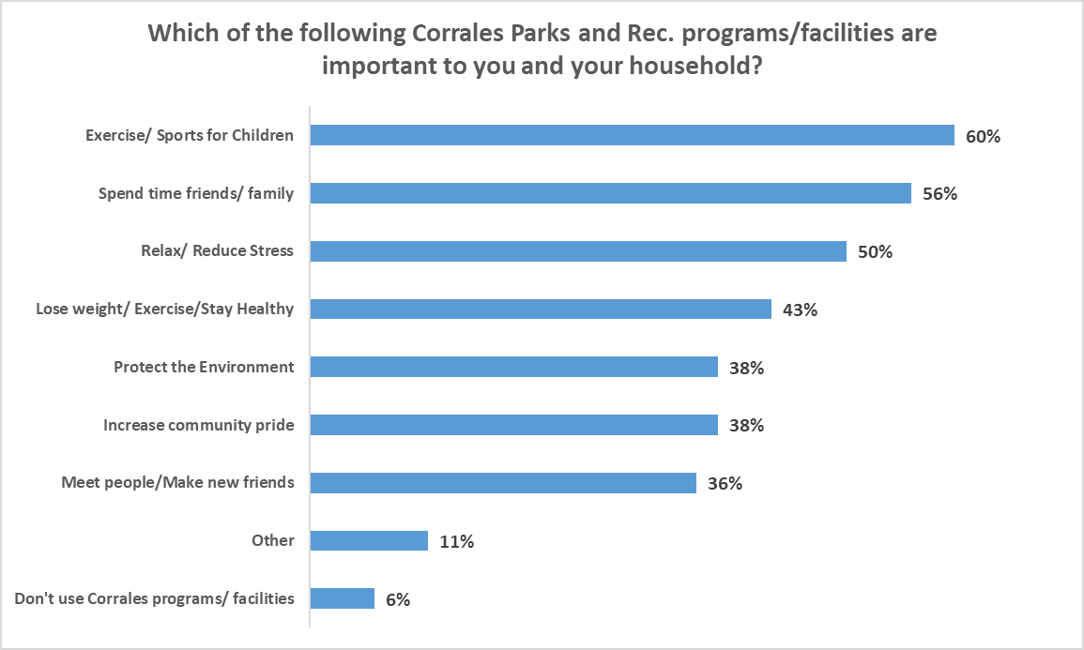

Slide 8
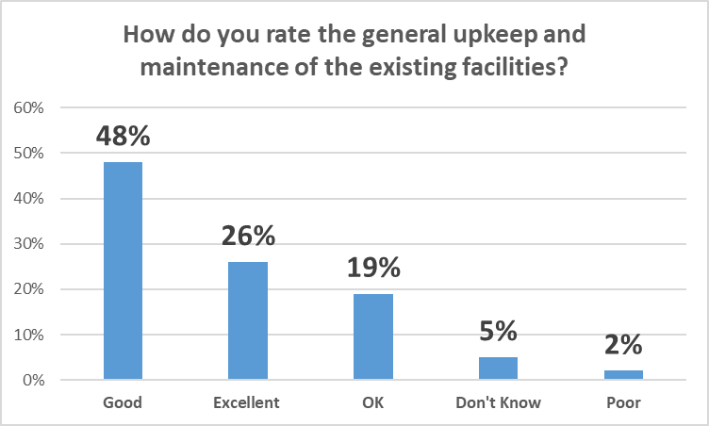

Slide 10
