Slide 1
Sagebrush Road-Thompson Fence Line Connection
Corrales Bicycle Pedestrian
Advisory Commission
6.16.20

Slide 2
History
The idea of a loop trail around Corrales was first imagined in the 1980s.
Rio Rancho completed the Thompson Fence Line Trail and Intel built their trail in the 1990s.
Together they provide a three-mile path along the border between Corrales and Rio Rancho that offers sweeping views of the Village and the Sandias.
Attempts to connect the north end to the village via Sagebrush have been ongoing for thirty years.
A few years ago the property on which a trail connection could be constructed was deeded to the village from SSCAFCA.
Mike Chavez, Village Public Works Director, viewed the possible connection, indicating it was doable and providing cost estimates.
This link is on the Master Trails Plan.
The neighborhood for the moment is stable and aware of the potential trail link.
Time is of the essence before more houses are constructed.

Slide 3
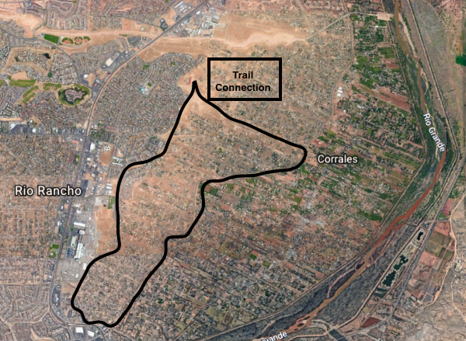
Aerial view
E: Loma Larga
S: Skyview Acres
W: Intel/Thompson Fence
N: Sagebrush

Slide 4
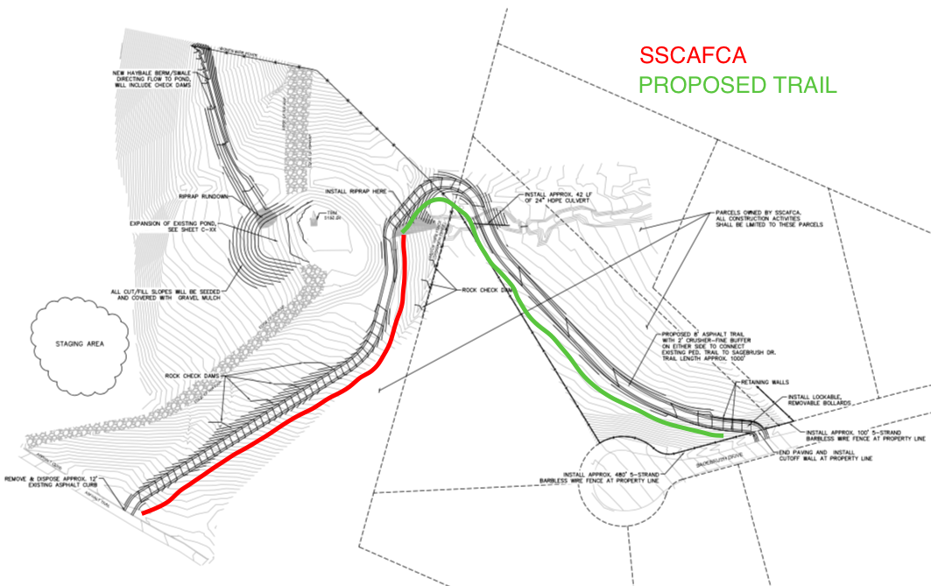

Slide 5
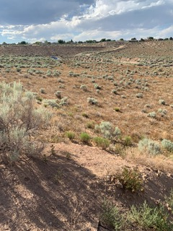
Site of proposed trail connection

Slide 6
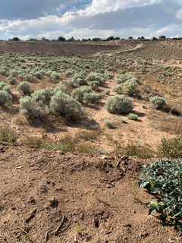
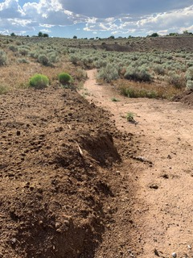
Current “ad-hoc” trails across private property

Slide 7
Cost Estimate of Corrales Bike Trails West End of Sagebrush Drive prepared by Corrales Public Works Dept. 2/2019

Slide 8
The Time Is Now
Parks and Recreation survey indicated residents want opportunities to exercise outside as individuals and as families.
Trail connectivity is an important tenet of the Trails Master Plan.
A loop trail is a great way to enjoy our Village.
Intel has recently finished improvements on TFL trail.
The Village owns the land on which the potential trail connection would be constructed.
Nearby lots are for sale. We have an agreement among current neighbors that the connection is a good idea.
Benefits are significant: health, quality of life, potential economic boost for local businesses.

